Slide 1
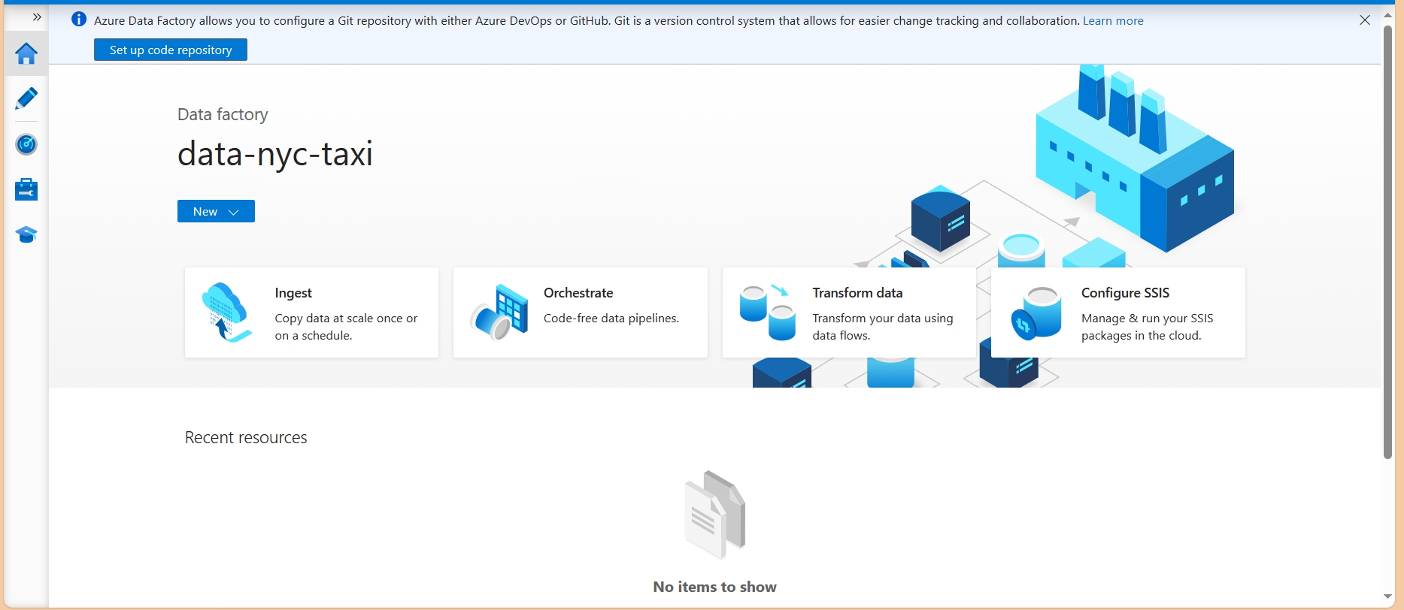
BY clicking the set up code repository
We will connect to GitHub/azure devops private GitHub
All the backend code generated will be store in that
BY connecting we can sent a pull request to publish and also we have option to save pipeline rather publish.

Slide 2
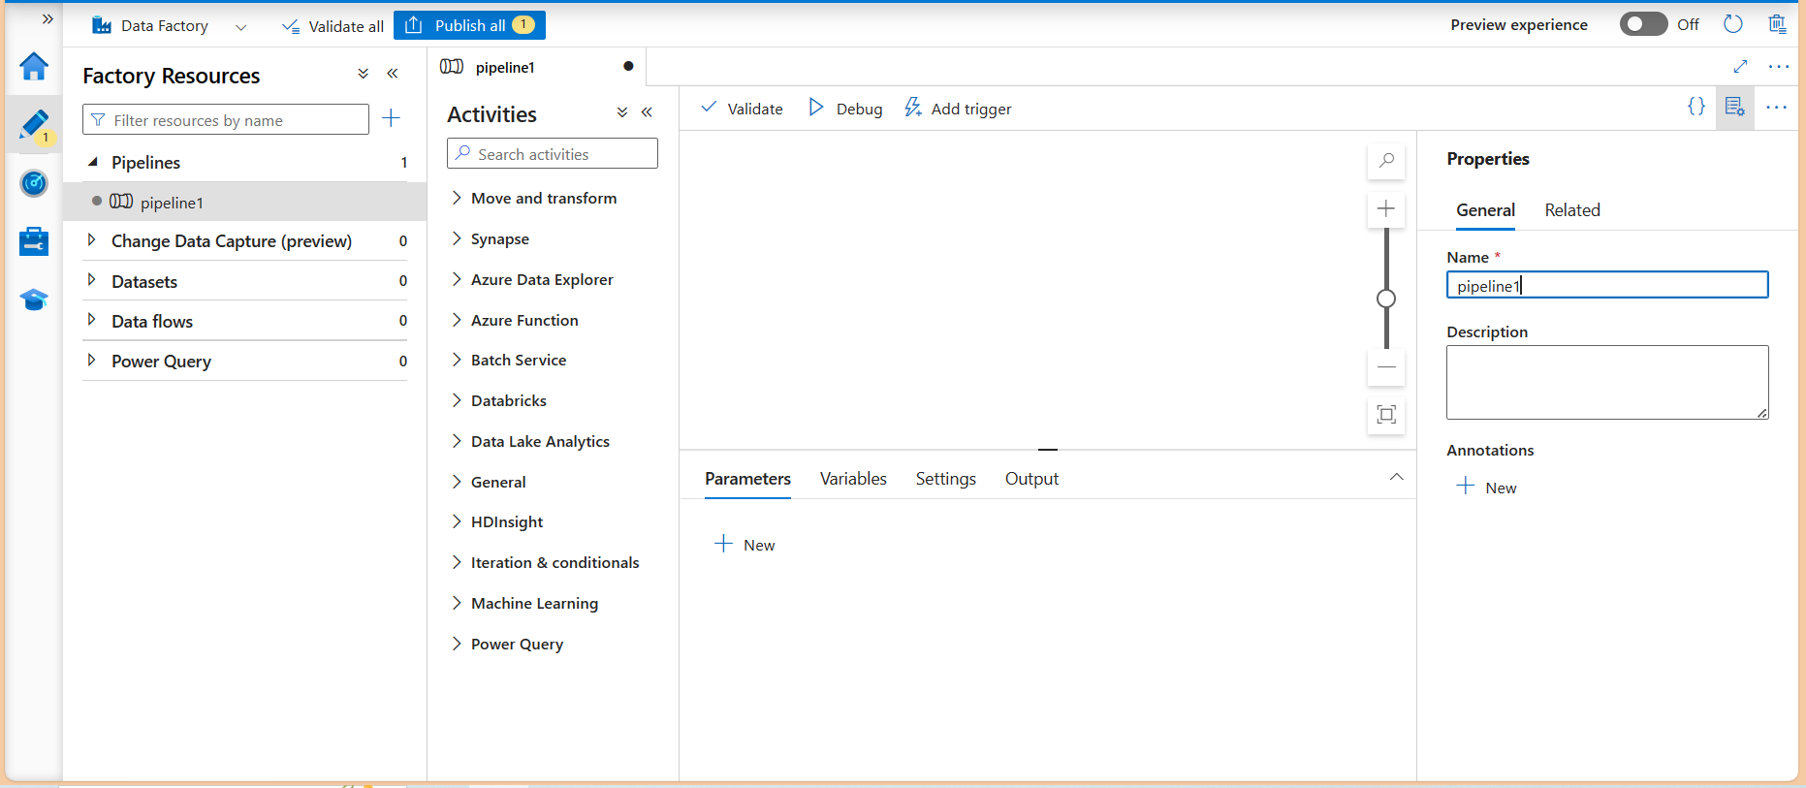
Click on author
In pipelines at the right click on … to create a new pipeline
After click on create new pipeline It will show like this

Slide 3
At the right in properties we can give a pipeline name
Click on icon right to {} on top to hide this pane
In pipeline these are the activities available to perform tasks.
We are going to pull data from GitHub where our monthly data resides.
We create 2 datasets
1 for source which point to GitHub
2 for destination which point to data lake gen2 container folder
We are also going to create
2 linked service which establish connection between dataset with their resource location
1 for GitHub
And another for data lake gen2 storage account container

Slide 4
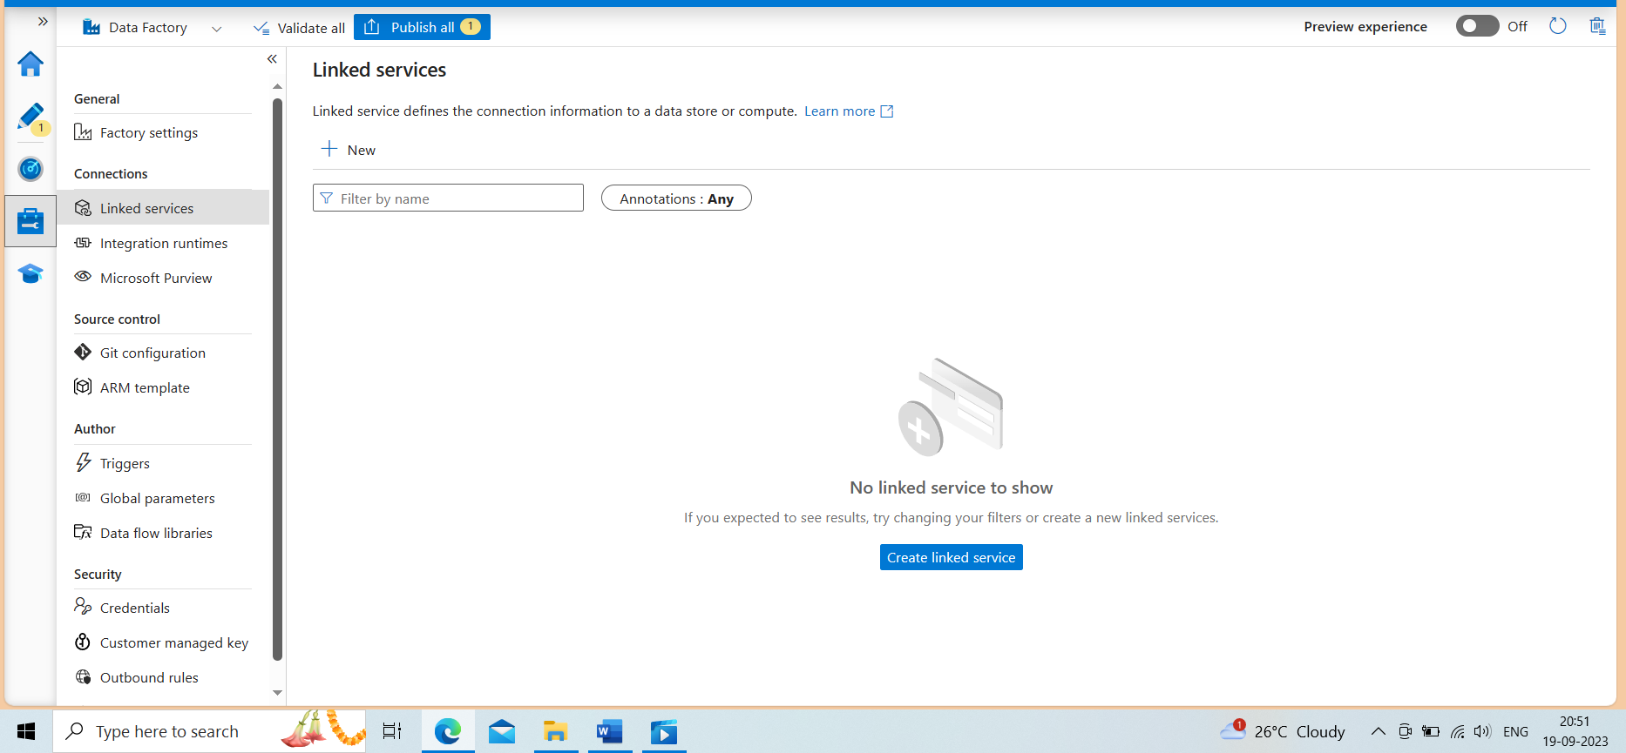
Click on manage to create linked service
Click new
Search HTTP and select

Slide 5
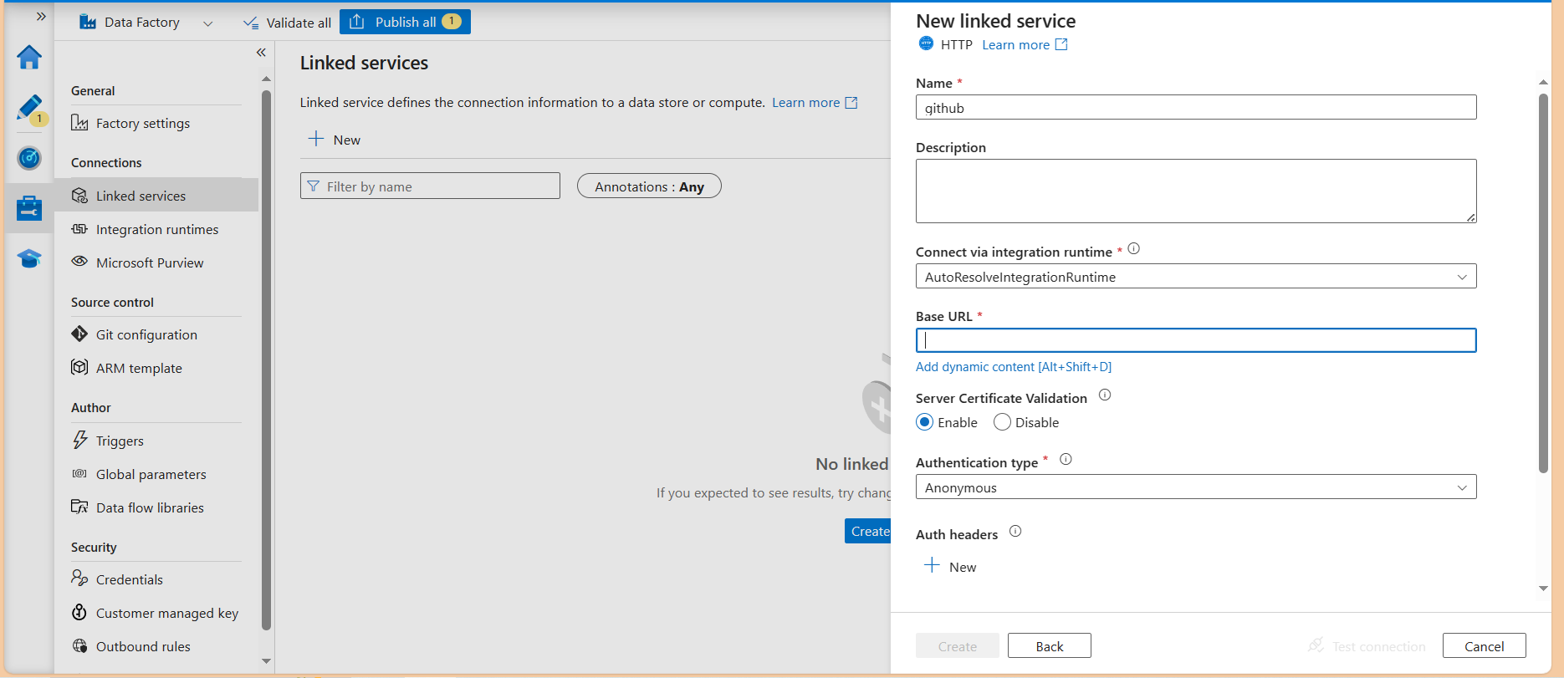
Creating this linked service as dynamic
Whenever required for next time to connect GitHub provide the base URL
Don’t need to create one
Click on add dynamic content

Slide 6
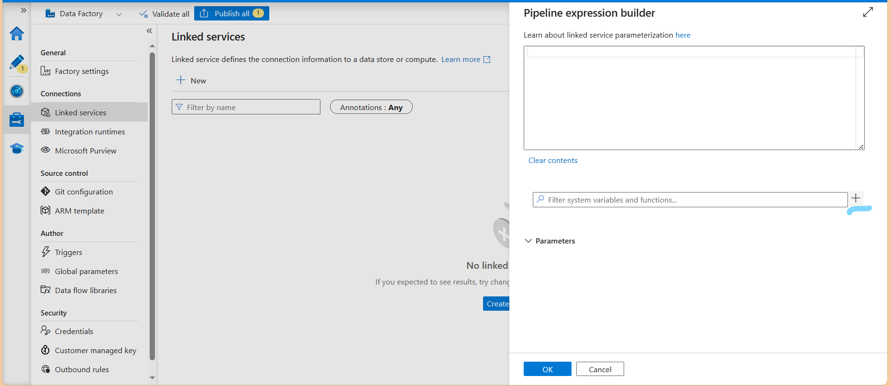
It will open this page
Click on + to create parameter

Slide 7
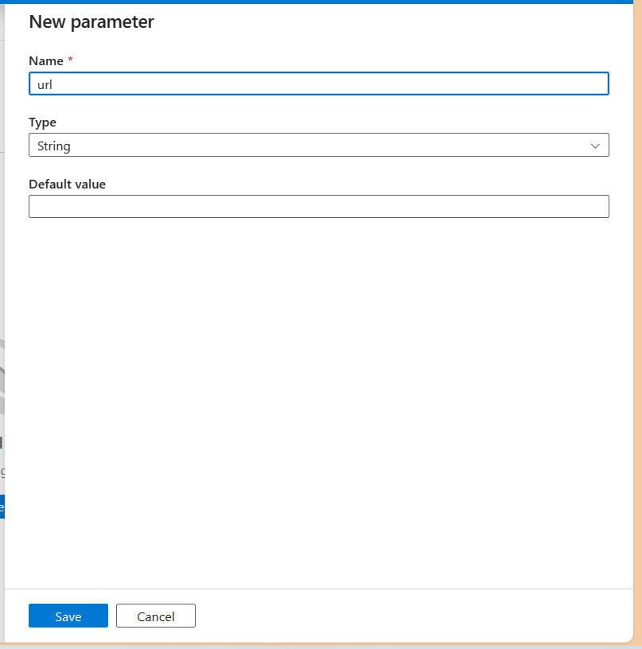
Give the name
URL
Type string
save

Slide 8
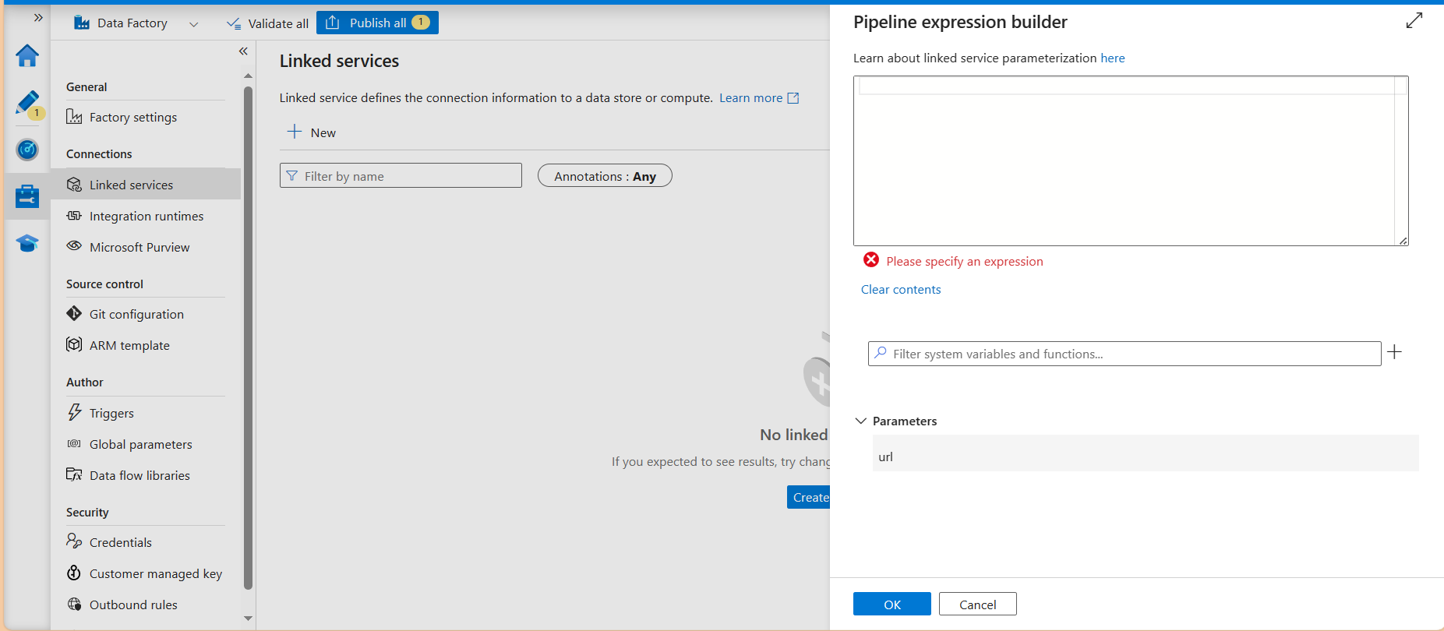
In parameters select URL
It will show up code in above canvas

Slide 9
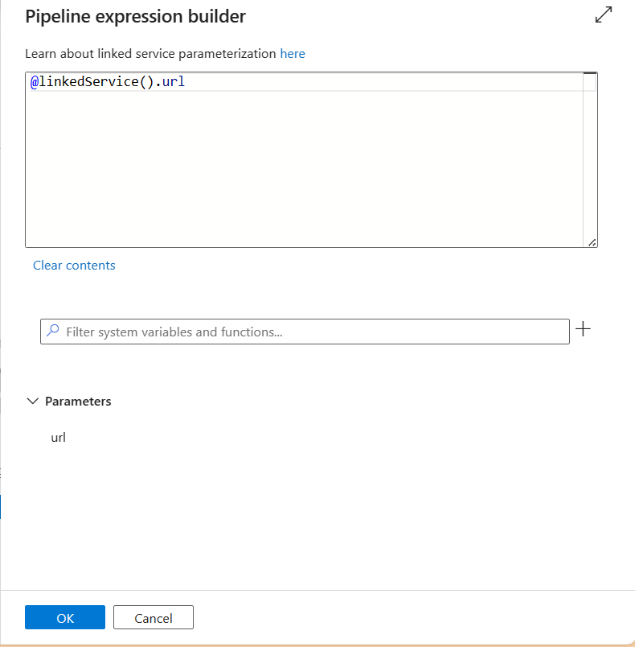
It will look like this
By clicking ok our link service become parameterization

Slide 10
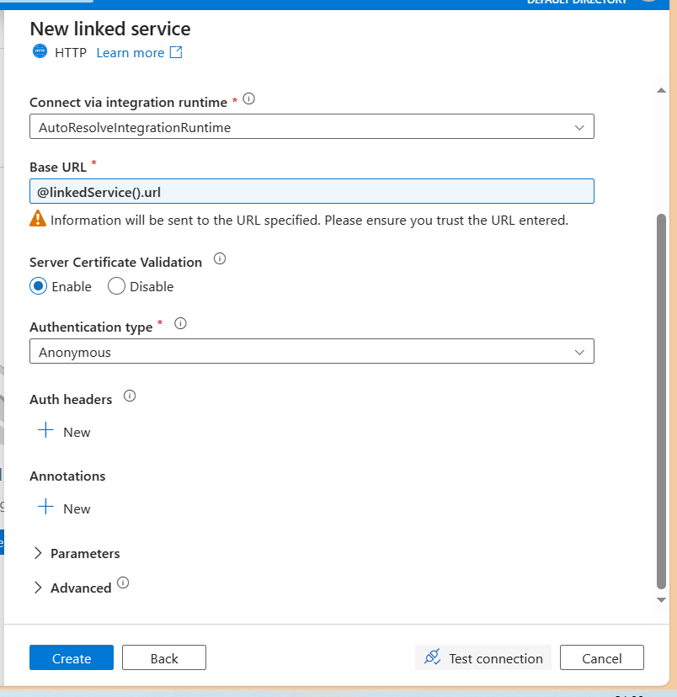
Choose authentication type anonymous to access GitHub
Click create
If the source here will not GitHub and if it has the source as azure service
We first test the connection
Then click on create

Slide 11
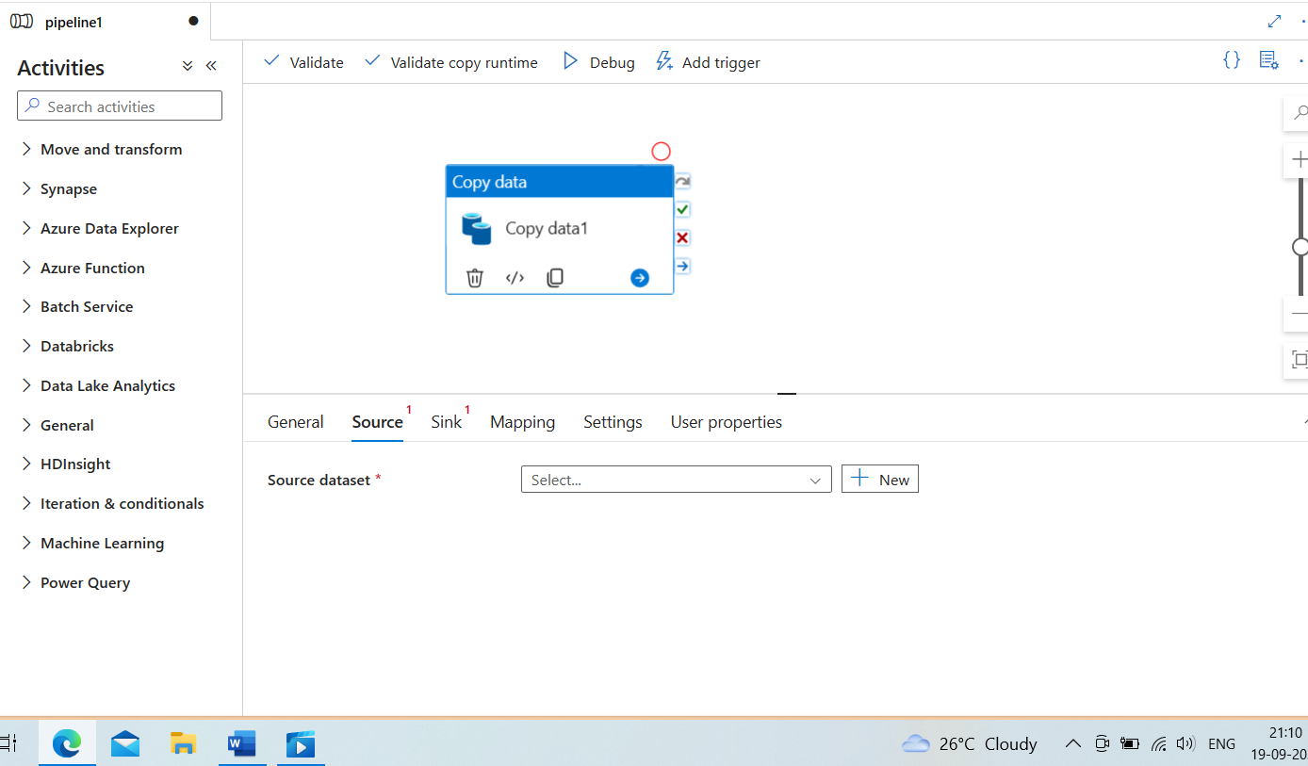
Drag and drop copy activity from move and transform
To copy the data from GitHub and store in data lake gen2 container

Slide 12
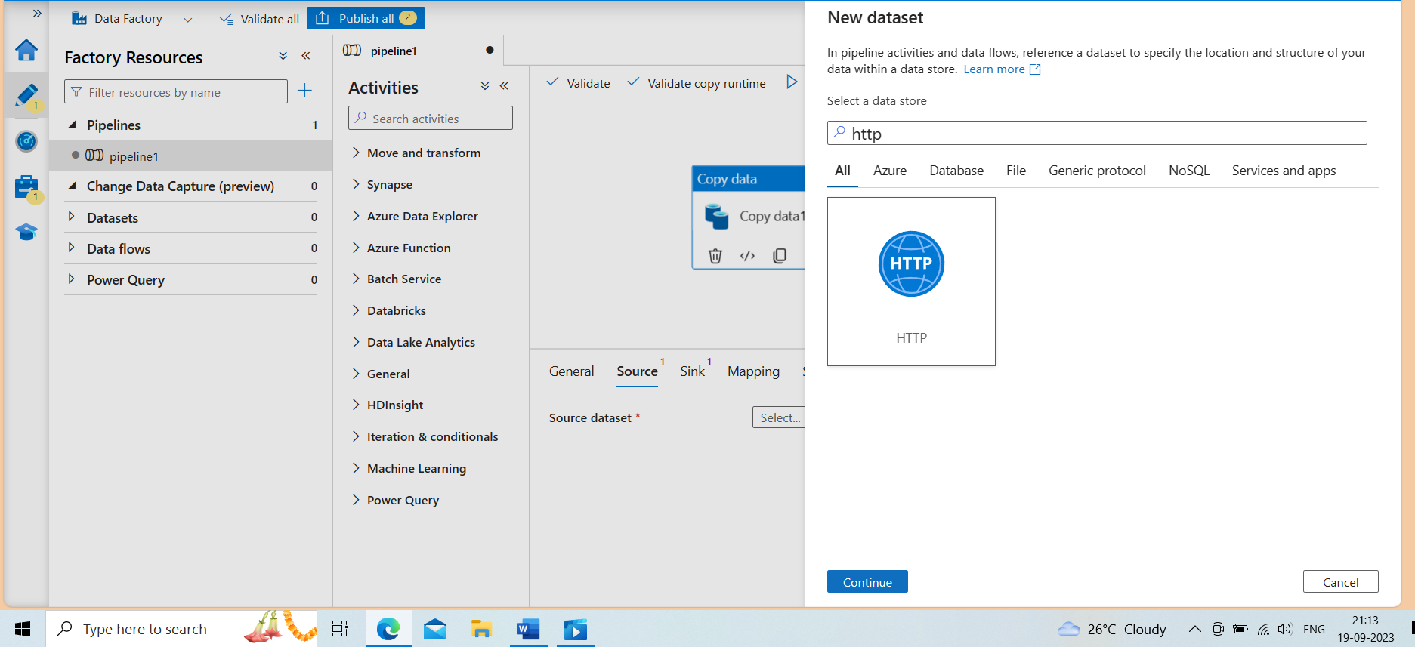
Creating Dataset which will reference to the source location
Click on source
Search http
continue

Slide 13
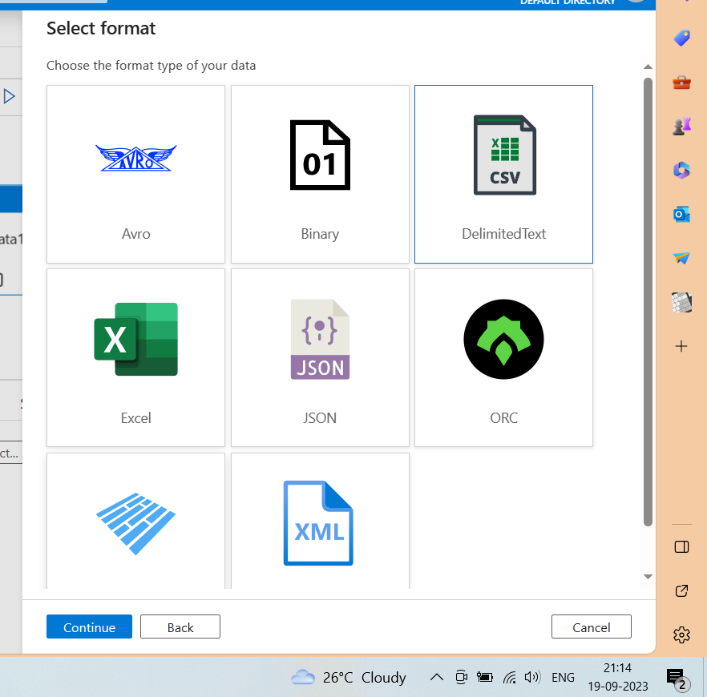
Select the format of existing data source where we copy the data.
Here we have csv format file
There are the available option to copy the format of file
Avro
Binary
Csv
Excel
Json
Orc
Parquet
xml

Slide 14
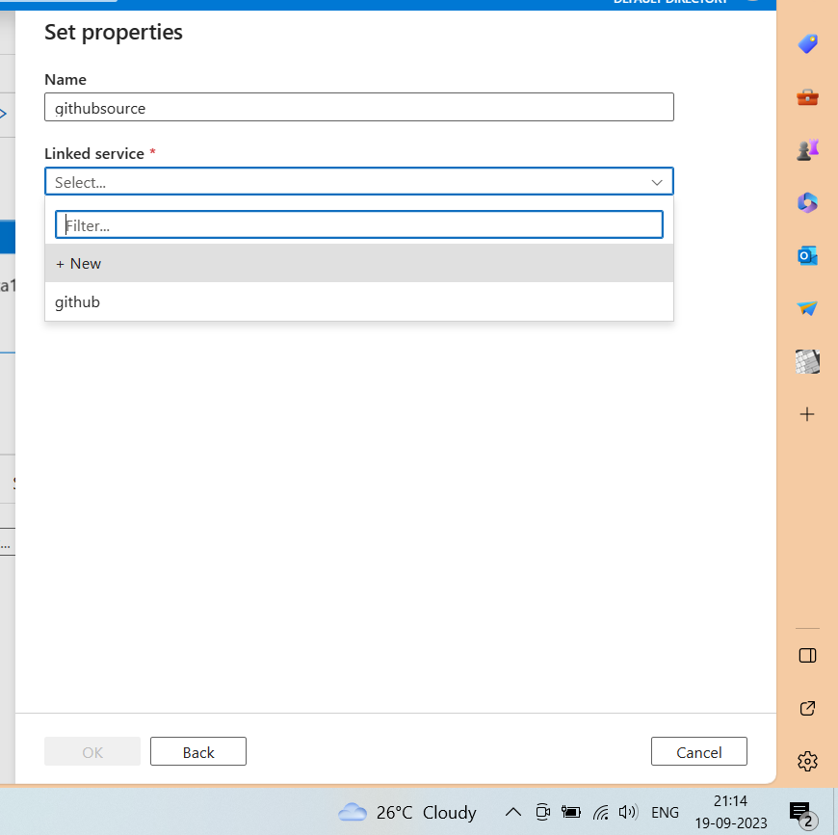
Give the dataset name
Select the linked service
GitHub as we created
In linked service there is a integration runtime available
Which works as computation engine
To retrieve data faster of how many size .
If the size is too large then we have to set integration runtime manually to set resource
So that it will not cost too much
Click ok

Slide 15
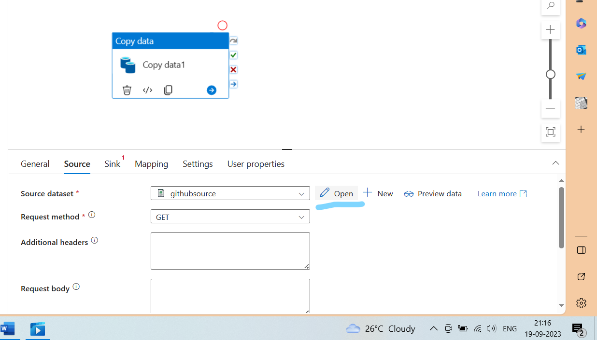
Click on open
It will open anew page named as GitHub source
Where we can set connection,schema,parameters

Slide 16
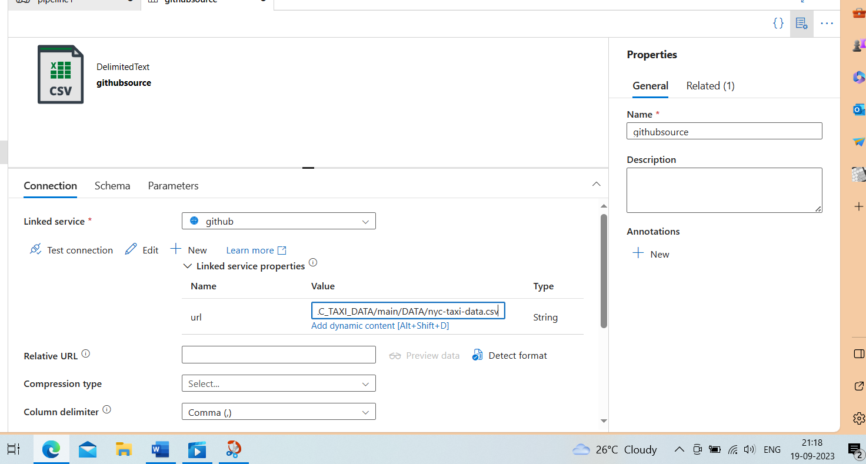
In URL paste the base URL
Column delimiter choose (,)

Slide 17
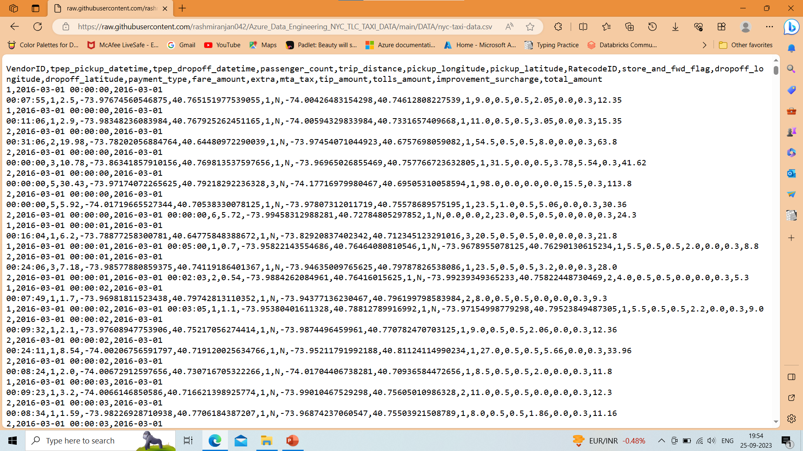
Copy the raw URL of GitHub nyc-taxi-data.csv
we paste this link in connection

Slide 18
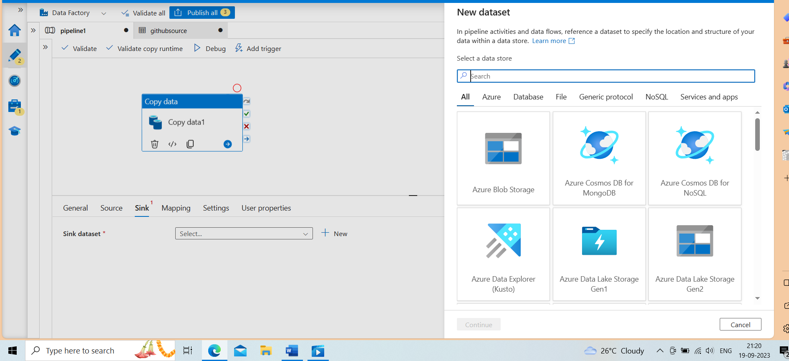
Click on copy data
Click sink
Select azure data lake storage gen2

Slide 19
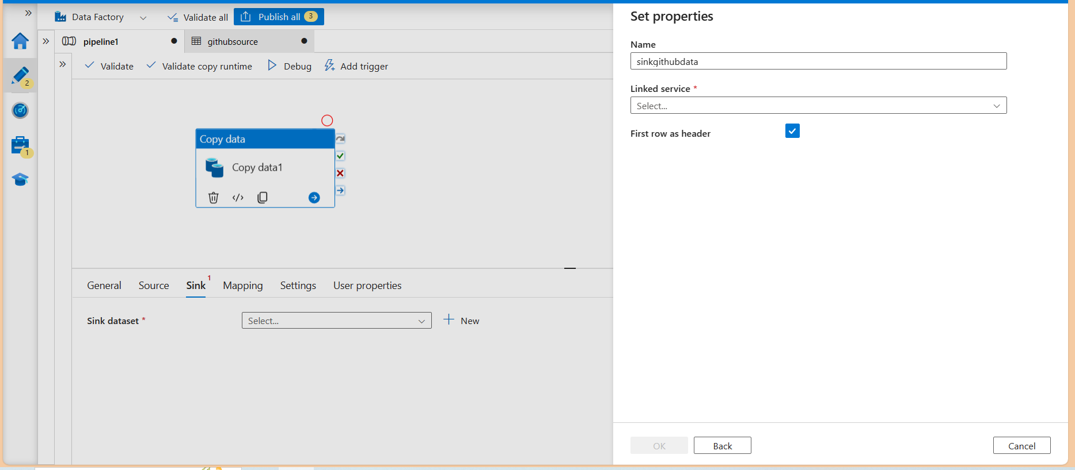
In Set properties
Name provide the sink dataset name
Linked service
New
First row as header checked

Slide 20
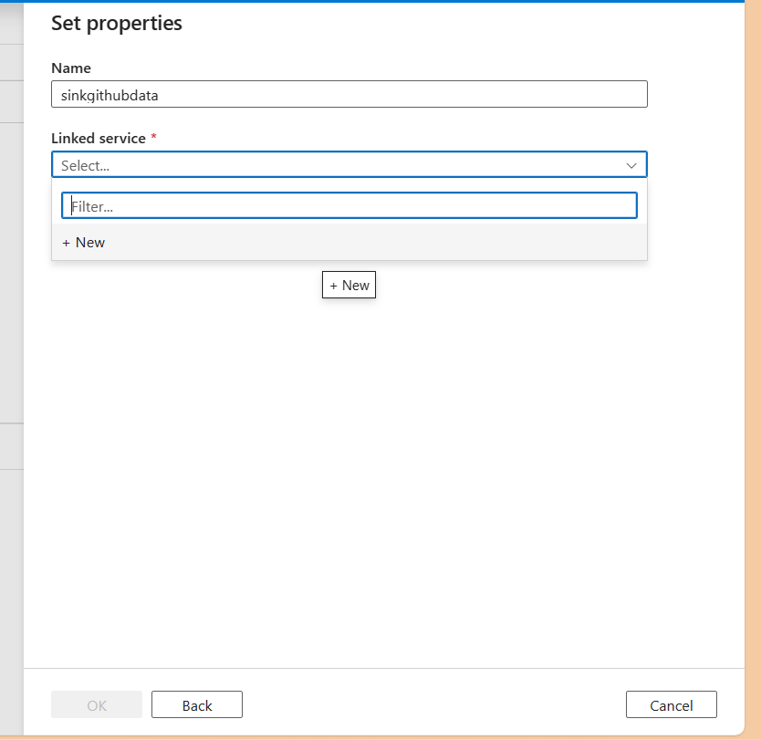
Creating new linked service

Slide 21
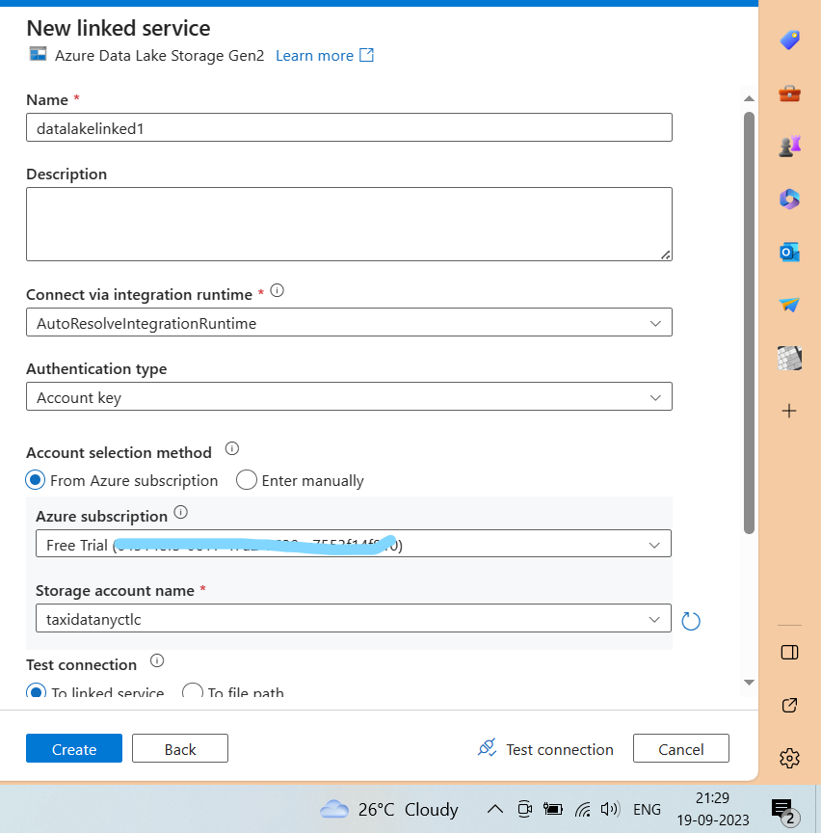
Here we create a new linked service store data in data lake storage gen2
Name
Datalakelinked1
Integration runtime
Auto resolve Integration runtime
Authentication type
Access key
Storage account name
Taxidatanyctlc
Click create

Slide 22
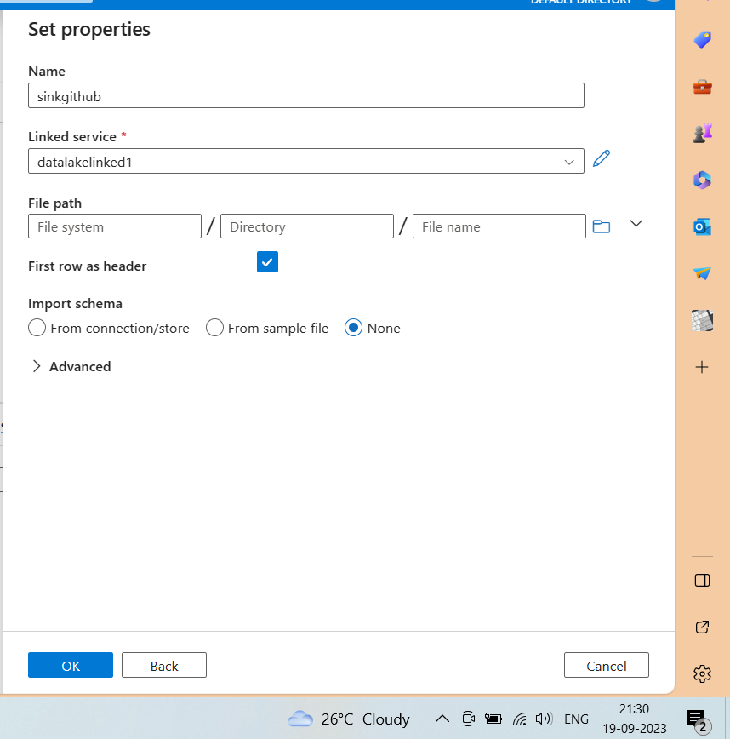
After linked service created successfully
Choose the linked service
Click on folder icon
Select the hierarchy as we select in windows
Import schema none
Click ok

Slide 23
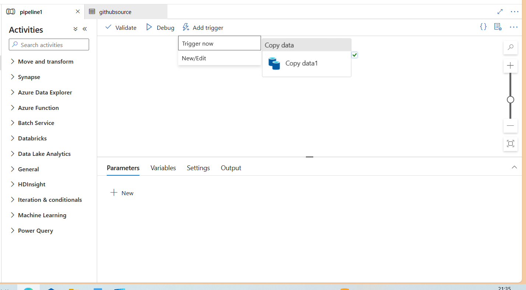
Here this is a monthly data , and we will do ad-hoc analytics
SO setting trigger now

Slide 24
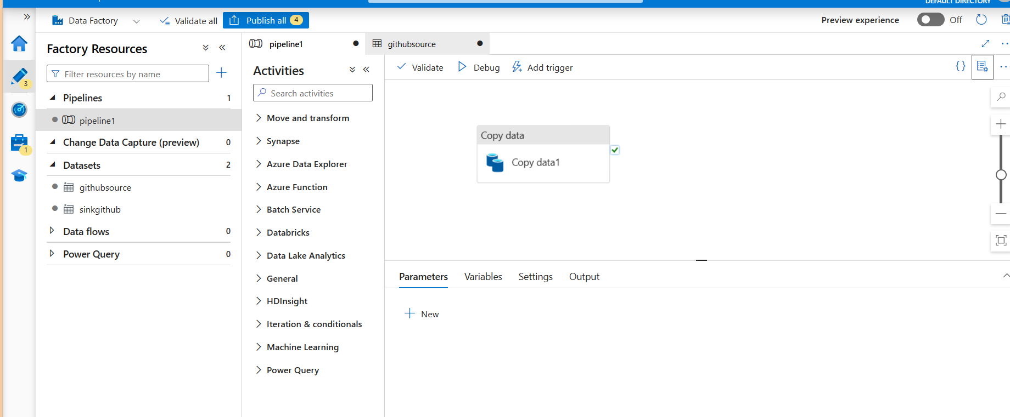

Slide 25
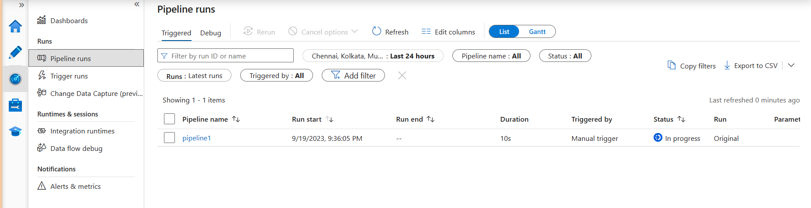
In monitor
Monitor the pipeline runs
That we trigger.
Now our data stored in data lake gen2

